Slide 1
VIRTUAL MEMORY
Background
Demand Paging
Process Creation
Page Replacement
Allocation of Frames
Thrashing
Demand Segmentation
Operating System Examples

Slide 2
BACKGROUND
Virtual memory – separation of user logical memory as perceived by users from physical memory.
Only part of the program needs to be in memory for execution.
Logical address space can therefore be much larger than physical address space.
Allows address spaces to be shared by several processes.
Allows for more efficient process creation.
It allows an extremely large virtual memory to be provided for programmer when only a smaller physical memory is available.
Makes programming task easier.
Virtual memory can be implemented via:
Demand paging
Demand segmentation

Slide 3
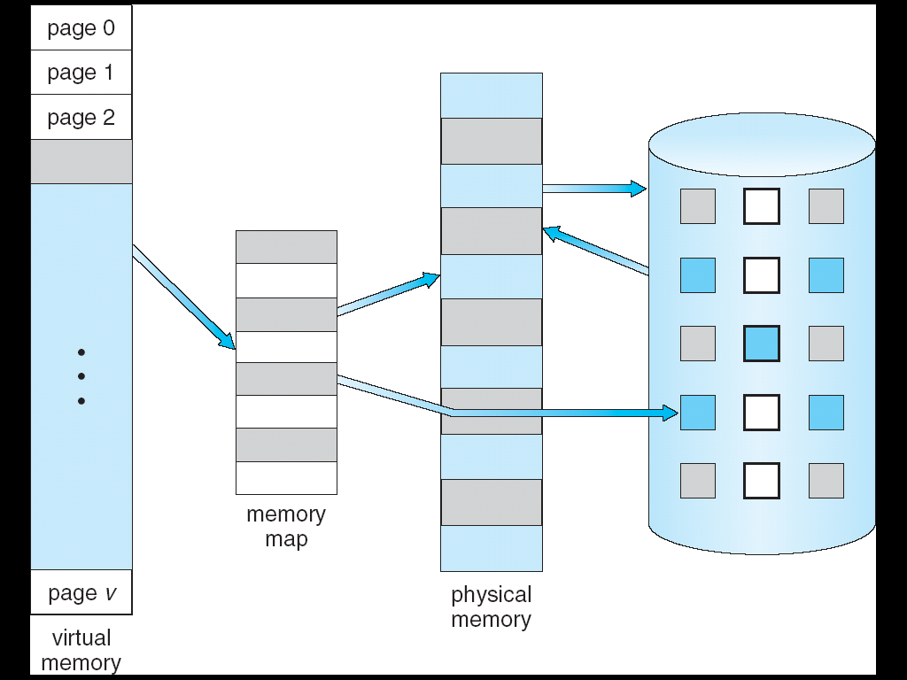
VIRTUAL MEMORY THAT IS LARGER THAN PHYSICAL MEMORY
⇒

Slide 4
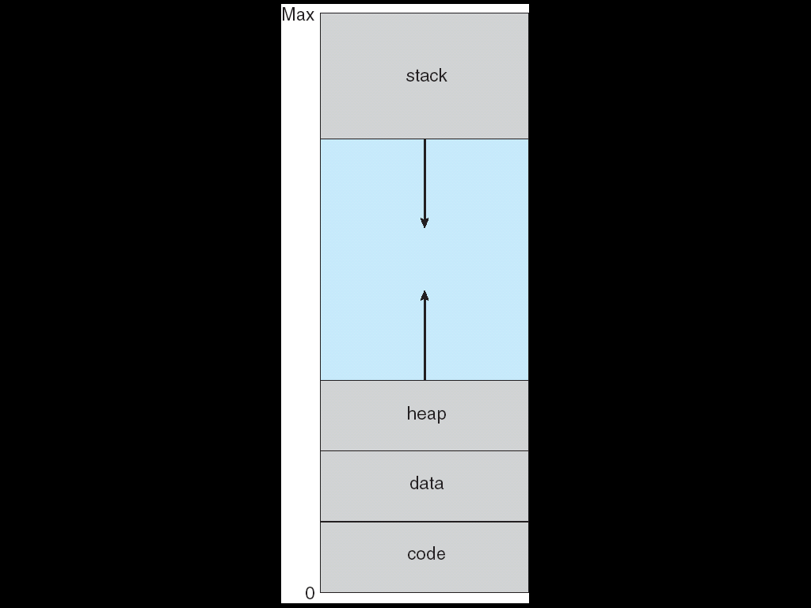
VIRTUAL-ADDRESS SPACE

Slide 5
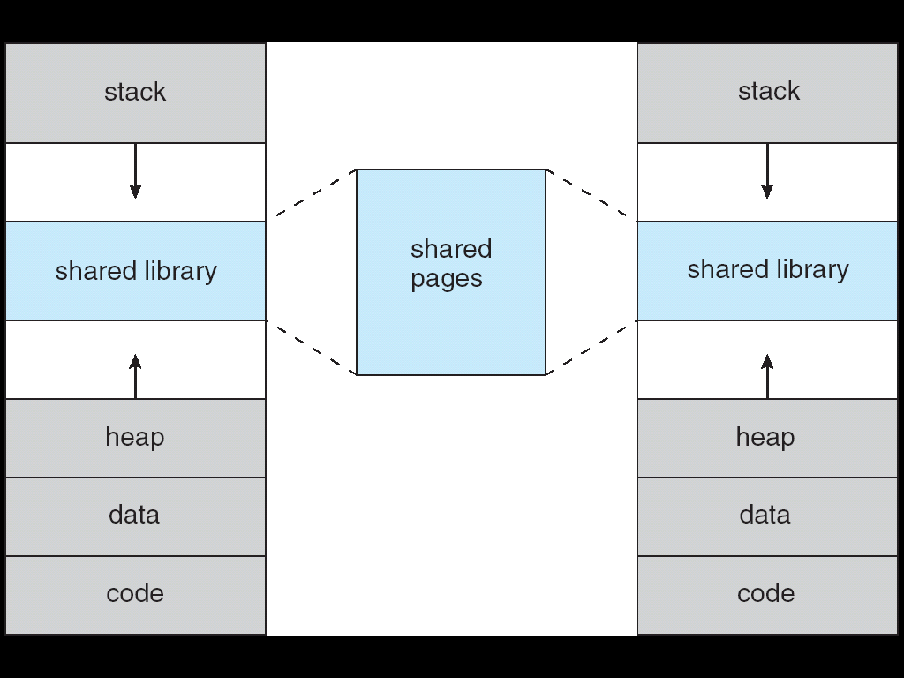
SHARED LIBRARY USING VIRTUAL MEMORY

Slide 6
DEMAND PAGING
Bring a page into memory only when it is needed
Less I/O needed
Less memory needed
Faster response
More users
Page is needed ⇒ reference to it
invalid reference ⇒ abort
not-in-memory ⇒ bring to memory

Slide 7
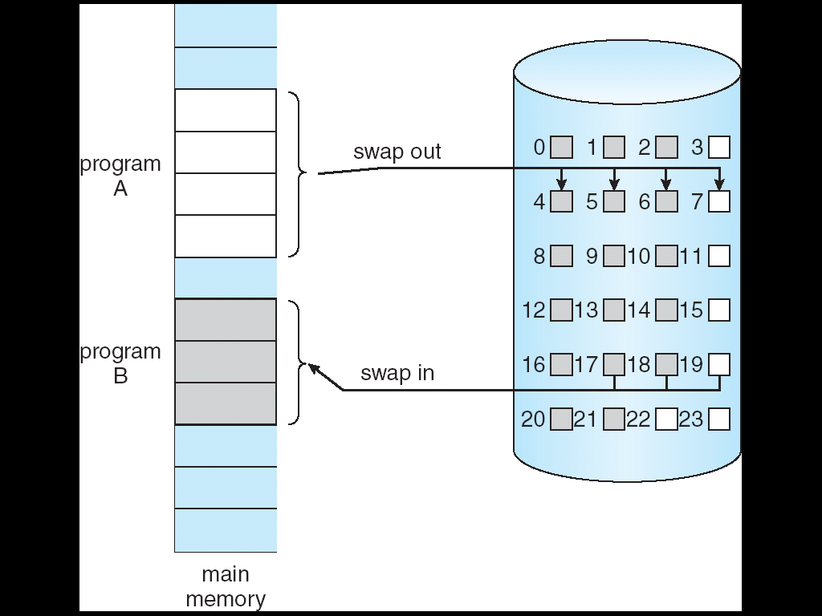
TRANSFER OF A PAGED MEMORY TO CONTIGUOUS DISK SPACE

Slide 8
VALID-INVALID BIT
With each page table entry a valid–invalid bit is associated (1 ⇒ in-memory, 0 ⇒ not-in-memory)
Initially valid–invalid but is set to 0 on all entries
Example of a page table snapshot:
During address translation, if valid–invalid bit in page table entry is 0 ⇒ page fault
Frame #
valid-invalid bit
1
1
1
1
0

0
0
page table

Slide 9
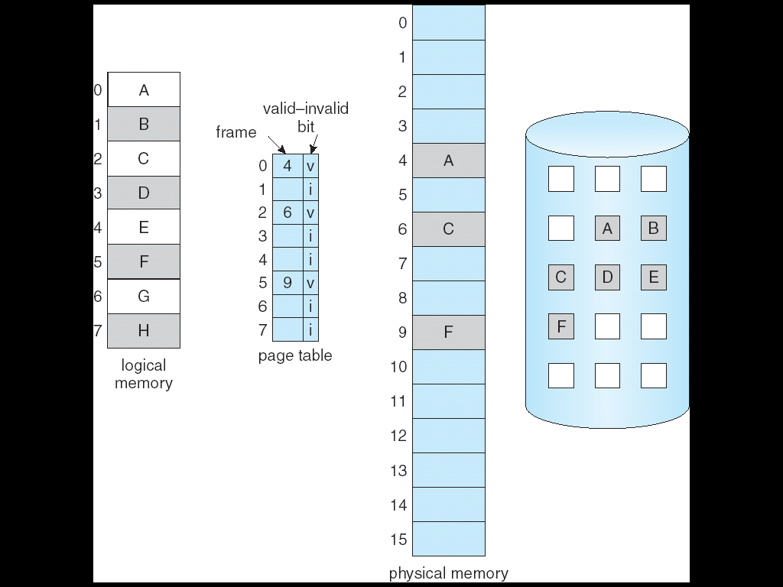
PAGE TABLE WHEN SOME PAGES ARE NOT IN MAIN MEMORY

Slide 10
PAGE FAULT
If there is ever a reference to a page, first reference will trap to OS ⇒ page fault
OS looks at another table to decide:
Invalid reference ⇒ abort.
Just not in memory.
Get empty frame.
Swap page into frame.
Reset tables, validation bit = 1.
Restart instruction: Least Recently Used
block move
auto increment/decrement location

Slide 11
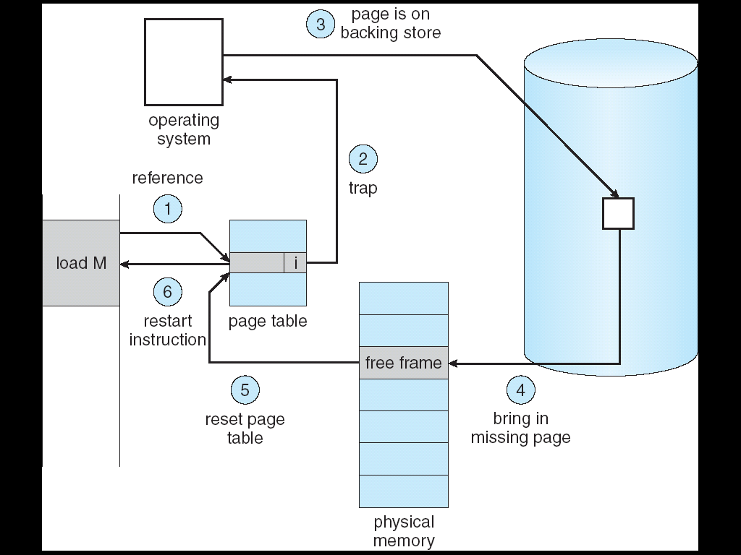
STEPS IN HANDLING A PAGE FAULT

Slide 12
WHAT HAPPENS IF THERE IS NO FREE FRAME?
Page replacement – find some page in memory, but not really in use, swap it out
algorithm
performance – want an algorithm which will result in minimum number of page faults
Same page may be brought into memory several times

Slide 13
PERFORMANCE OF DEMAND PAGING
Page Fault Rate 0 ≤ p ≤ 1.0
if p = 0 no page faults
if p = 1, every reference is a fault
Effective Access Time (EAT)
EAT = (1 – p) x memory access
+ p (page fault overhead
+ [swap page out ]
+ swap page in
+ restart overhead)

Slide 14
DEMAND PAGING EXAMPLE
Memory access time = 1 microsecond
50% of the time the page that is being replaced has been modified and therefore needs to be swapped out
Swap Page Time = 10 msec = 10,000 msec
EAT = (1 – p) x 1 + p (15000)
1 + 15000P (in msec)

Slide 15
PROCESS CREATION
Virtual memory allows other benefits during process creation:
- Copy-on-Write
- Memory-Mapped Files (later)

Slide 16
COPY-ON-WRITE
Copy-on-Write (COW) allows both parent and child processes to initially share the same pages in memory If either process modifies a shared page, only then is the page copied
COW allows more efficient process creation as only modified pages are copied
Free pages are allocated from a pool of zeroed-out pages

Slide 17
PAGE REPLACEMENT
Prevent over-allocation of memory by modifying page-fault service routine to include page replacement
Use modify (dirty) bit to reduce overhead of page transfers – only modified pages are written to disk
Page replacement completes separation between logical memory and physical memory – large virtual memory can be provided on a smaller physical memory

Slide 18
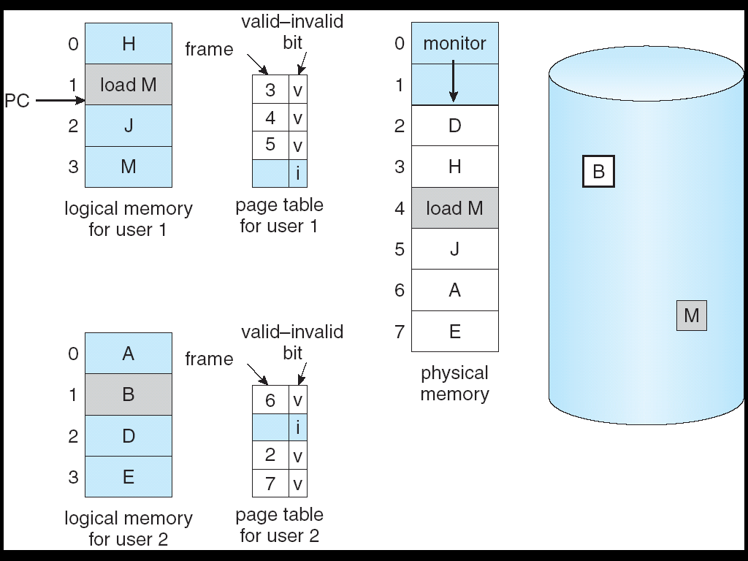
NEED FOR PAGE REPLACEMENT

Slide 19
BASIC PAGE REPLACEMENT
Find the location of the desired page on disk
Find a free frame: - If there is a free frame, use it - If there is no free frame, use a page replacement algorithm to select a victim frame
Read the desired page into the (newly) free frame. Update the page and frame tables.
Restart the process

Slide 20
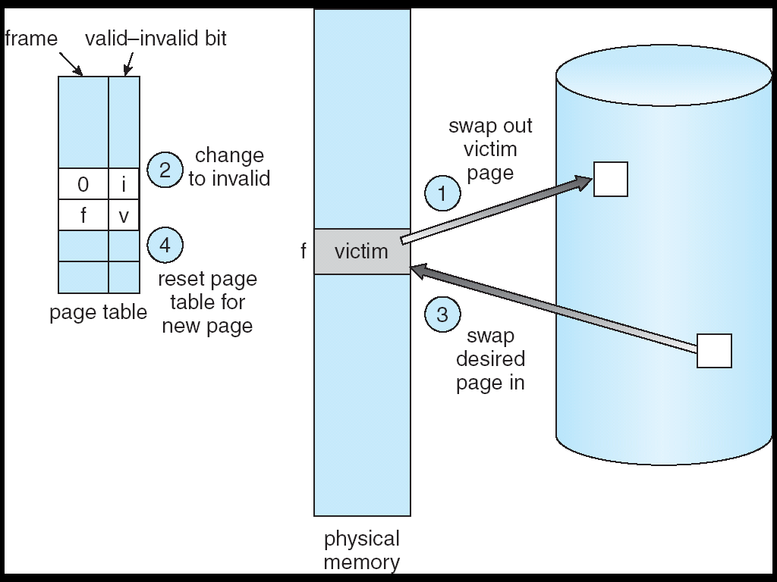
PAGE REPLACEMENT

Slide 21
PAGE REPLACEMENT ALGORITHMS
Want lowest page-fault rate
Evaluate algorithm by running it on a particular string of memory references (reference string) and computing the number of page faults on that string
In all our examples, the reference string is
1, 2, 3, 4, 1, 2, 5, 1, 2, 3, 4, 5

Slide 22
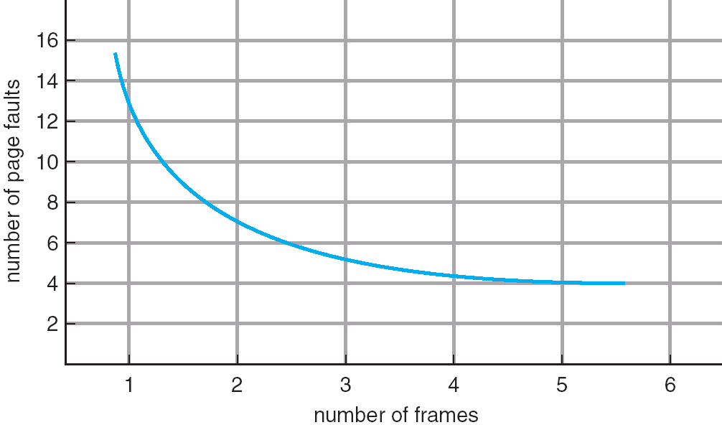
Graph of Page Faults Versus The Number of Frames

Slide 23
First-In-First-Out (FIFO) Algorithm
Reference string: 1, 2, 3, 4, 1, 2, 5, 1, 2, 3, 4, 5
3 frames (3 pages can be in memory at a time per process)
4 frames
FIFO Replacement – Belady’s Anomaly
more frames ⇒ more page faults
1
1
4
5
2
2
1
3
9 page faults
3
3
2
4
1
1
5
4
2
2
1
5
10 page faults
3
3
2
4
4
3

Slide 24
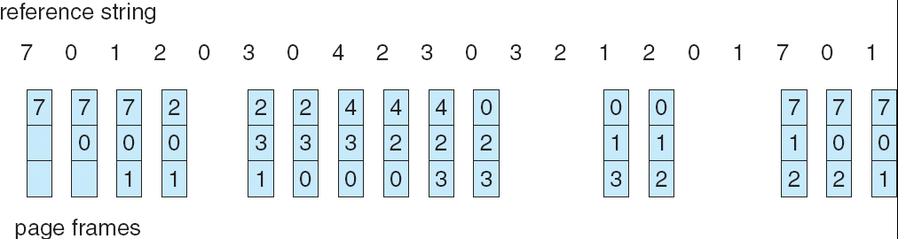
FIFO Page Replacement

Slide 25
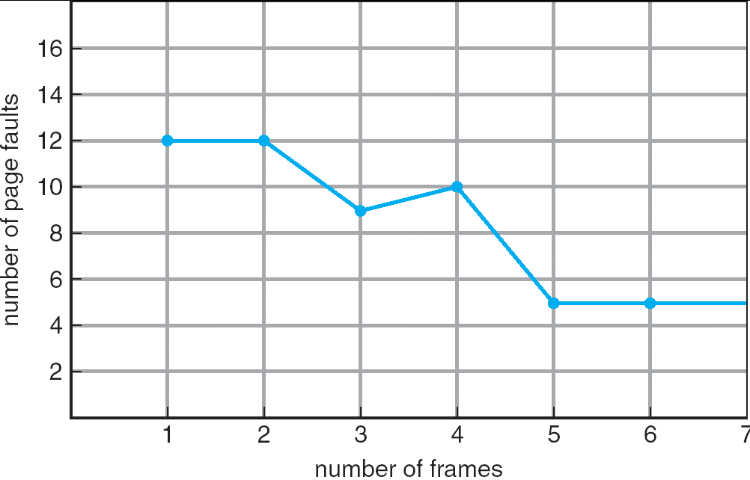
FIFO Illustrating Belady’s Anomaly

Slide 26
Optimal Algorithm
Replace page that will not be used for longest period of time
4 frames example
1, 2, 3, 4, 1, 2, 5, 1, 2, 3, 4, 5
How do you know this?
Used for measuring how well your algorithm performs
1
4
2
6 page faults
3
4
5

Slide 27
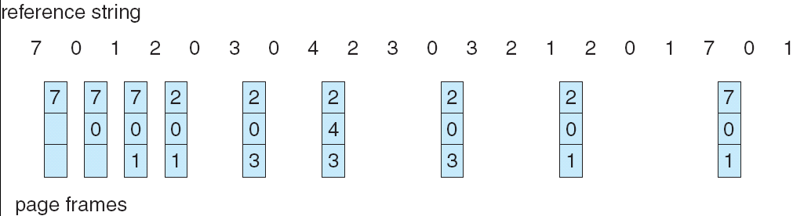
Optimal Page Replacement

Slide 28
Least Recently Used (LRU) Algorithm
Reference string: 1, 2, 3, 4, 1, 2, 5, 1, 2, 3, 4, 5
Counter implementation
Every page entry has a counter; every time page is referenced through this entry, copy the clock into the counter
When a page needs to be changed, look at the counters to determine which are to change
1
5
2
3
5
4
4
3

Slide 29
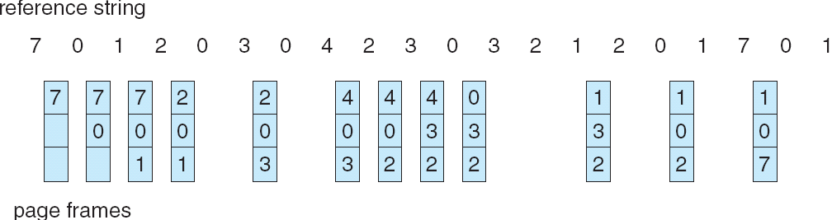
LRU Page Replacement

Slide 30
LRU Algorithm (Cont.)
Stack implementation – keep a stack of page numbers in a double link form:
Page referenced:
move it to the top
requires 6 pointers to be changed
No search for replacement

Slide 31
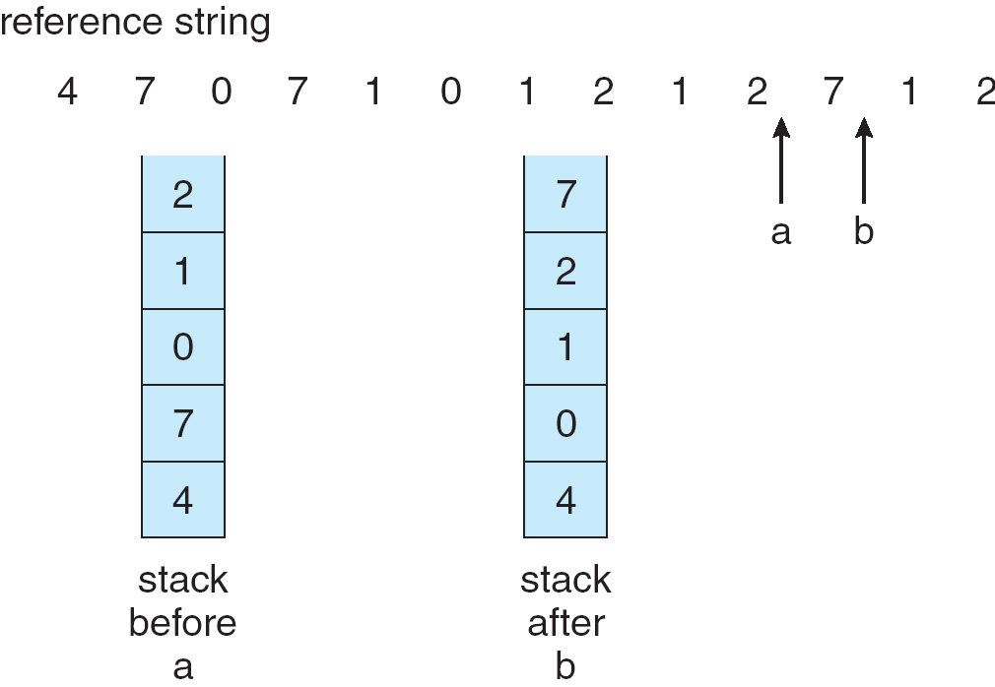
Use Of A Stack to Record The Most Recent Page References

Slide 32
LRU Approximation Algorithms
Reference bit
With each page associate a bit, initially = 0
When page is referenced bit set to 1
Replace the one which is 0 (if one exists). We do not know the order, however.
Second chance
Need reference bit
Clock replacement
If page to be replaced (in clock order) has reference bit = 1 then:
set reference bit 0
leave page in memory
replace next page (in clock order), subject to same rules

Slide 33
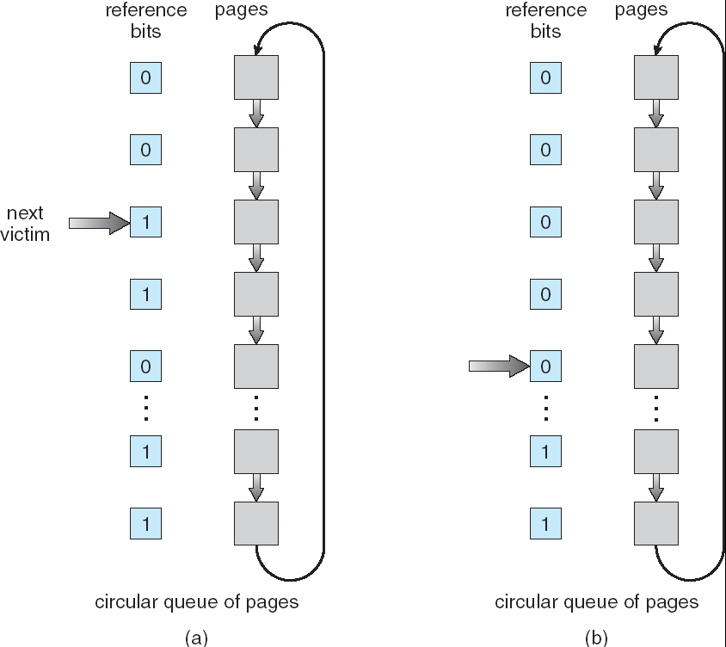
Second-Chance (clock) Page-Replacement Algorithm

Slide 34
Counting Algorithms
Keep a counter of the number of references that have been made to each page
LFU Algorithm: replaces page with smallest count
MFU Algorithm: based on the argument that the page with the smallest count was probably just brought in and has yet to be used

Slide 35
Allocation of Frames
Each process needs minimum number of pages
Example: IBM 370 – 6 pages to handle SS MOVE instruction:
instruction is 6 bytes, might span 2 pages
2 pages to handle from
2 pages to handle to
Two major allocation schemes
fixed allocation
priority allocation

Slide 36
Fixed Allocation
Equal allocation – For example, if there are 100 frames and 5 processes, give each process 20 frames.
Proportional allocation – Allocate according to the size of process

Slide 37
Priority Allocation
Use a proportional allocation scheme using priorities rather than size
If process P_{i} generates a page fault,
select for replacement one of its frames
select for replacement a frame from a process with lower priority number

Slide 38
Global vs. Local Allocation
Global replacement – process selects a replacement frame from the set of all frames; one process can take a frame from another
Local replacement – each process selects from only its own set of allocated frames

Slide 39
Thrashing
If a process does not have “enough” pages, the page-fault rate is very high. This leads to:
low CPU utilization
operating system thinks that it needs to increase the degree of multiprogramming
another process added to the system
Thrashing ≡ a process is busy swapping pages in and out

Slide 40
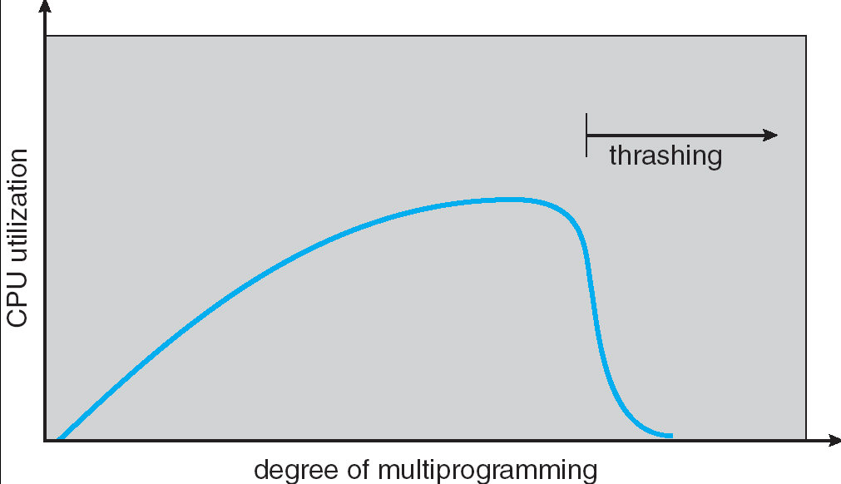
Thrashing (Cont.)

Slide 41
Demand Paging and Thrashing
Why does demand paging work? Locality model
Process migrates from one locality to another
Localities may overlap
Why does thrashing occur? Σ size of locality > total memory size

Slide 42
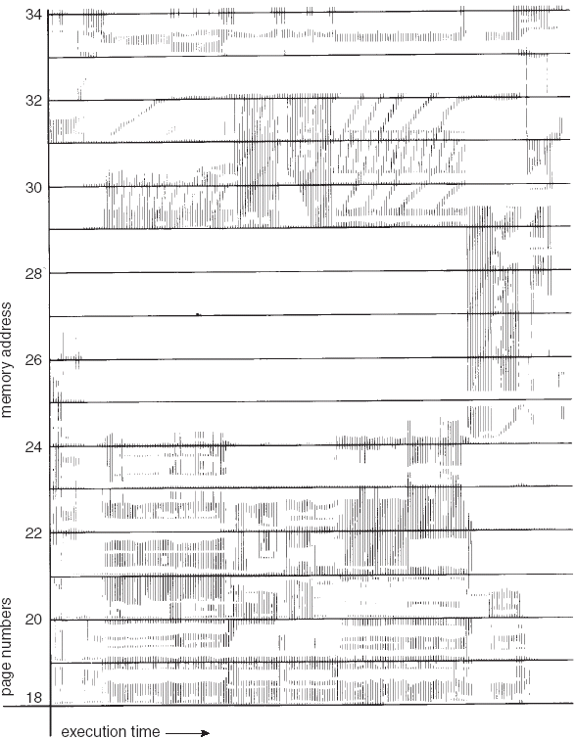
Locality In A Memory-Reference Pattern

Slide 43
Working-Set Model
Δ ≡ working-set window ≡ a fixed number of page references Example: 10,000 instruction
WSS_{i} (working set of Process P_{i}) = total number of pages referenced in the most recent Δ (varies in time)
if Δ too small will not encompass entire locality
if Δ too large will encompass several localities
if Δ = ∞ ⇒ will encompass entire program
D = Σ WSS_{i} ≡ total demand frames
if D > m ⇒ Thrashing
Policy if D > m, then suspend one of the processes

Slide 44
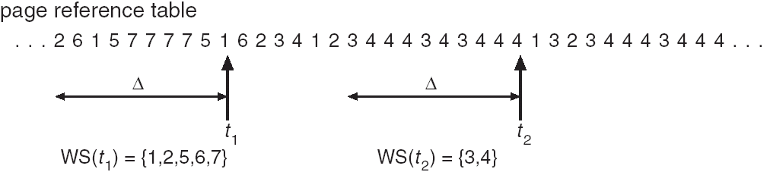
Working-set model

Slide 45
Keeping Track of the Working Set
Approximate with interval timer + a reference bit
Example: Δ = 10,000
Timer interrupts after every 5000 time units
Keep in memory 2 bits for each page
Whenever a timer interrupts copy and sets the values of all reference bits to 0
If one of the bits in memory = 1 ⇒ page in working set
Why is this not completely accurate?
Improvement = 10 bits and interrupt every 1000 time units

Slide 46
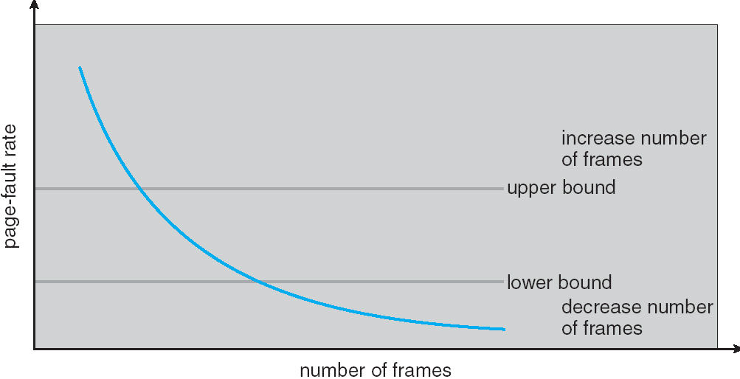
Page-Fault Frequency Scheme
Establish “acceptable” page-fault rate
If actual rate too low, process loses frame
If actual rate too high, process gains frame

Slide 47
Memory-Mapped Files
Memory-mapped file I/O allows file I/O to be treated as routine memory access by mapping a disk block to a page in memory
A file is initially read using demand paging. A page-sized portion of the file is read from the file system into a physical page. Subsequent reads/writes to/from the file are treated as ordinary memory accesses.
Simplifies file access by treating file I/O through memory rather than read() write() system calls
Also allows several processes to map the same file allowing the pages in memory to be shared

Slide 48
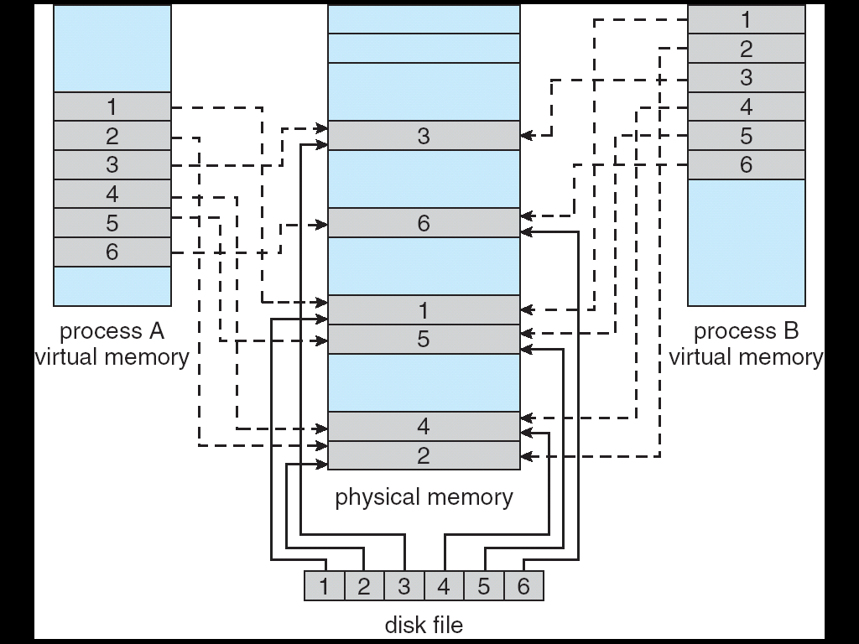
Memory Mapped Files

Slide 49
Memory-Mapped Files in Java
import java.io.*;
import java.nio.*;
import java.nio.channels.*;
public class MemoryMapReadOnly
{
// Assume the page size is 4 KB
public static final int PAGE SIZE = 4096;
public static void main(String args[]) throws IOException {
RandomAccessFile inFile = new RandomAccessFile(args[0],"r");
FileChannel in = inFile.getChannel();
MappedByteBuffer mappedBuffer =
in.map(FileChannel.MapMode.READ ONLY, 0, in.size());
long numPages = in.size() / (long)PAGE SIZE;
if (in.size() % PAGE SIZE > 0)
++numPages;

Slide 50
Memory-Mapped Files in Java (cont)
// we will "touch" the first byte of every page
int position = 0;
for (long i = 0; i < numPages; i++) {
byte item = mappedBuffer.get(position);
position += PAGE SIZE;
}
in.close();
inFile.close();
}
}
The API for the map() method is as follows:
map(mode, position, size)

Slide 51
Other Issues -- Prepaging
Prepaging
To reduce the large number of page faults that occurs at process startup
Prepage all or some of the pages a process will need, before they are referenced
But if prepaged pages are unused, I/O and memory was wasted
Assume s pages are prepaged and α of the pages is used
Is cost of s * α save pages faults > or < than the cost of prepaging s * (1- α) unnecessary pages?
α near zero ⇒ prepaging loses

Slide 52
Other Issues – Page Size
Page size selection must take into consideration:
fragmentation
table size
I/O overhead
locality

Slide 53
Other Issues – TLB Reach
TLB Reach - The amount of memory accessible from the TLB
TLB Reach = (TLB Size) X (Page Size)
Ideally, the working set of each process is stored in the TLB. Otherwise there is a high degree of page faults.
Increase the Page Size. This may lead to an increase in fragmentation as not all applications require a large page size
Provide Multiple Page Sizes. This allows applications that require larger page sizes the opportunity to use them without an increase in fragmentation.

Slide 54
Other Issues – Program Structure
Program structure
Int[128,128] data;
Each row is stored in one page
Program 1
for (j = 0; j <128; j++) for (i = 0; i < 128; i++) data[i,j] = 0;
128 x 128 = 16,384 page faults
Program 2
for (i = 0; i < 128; i++) for (j = 0; j < 128; j++) data[i,j] = 0;
128 page faults

Slide 55
Other Issues – I/O interlock
I/O Interlock – Pages must sometimes be locked into memory
Consider I/O. Pages that are used for copying a file from a device must be locked from being selected for eviction by a page replacement algorithm.

Slide 56
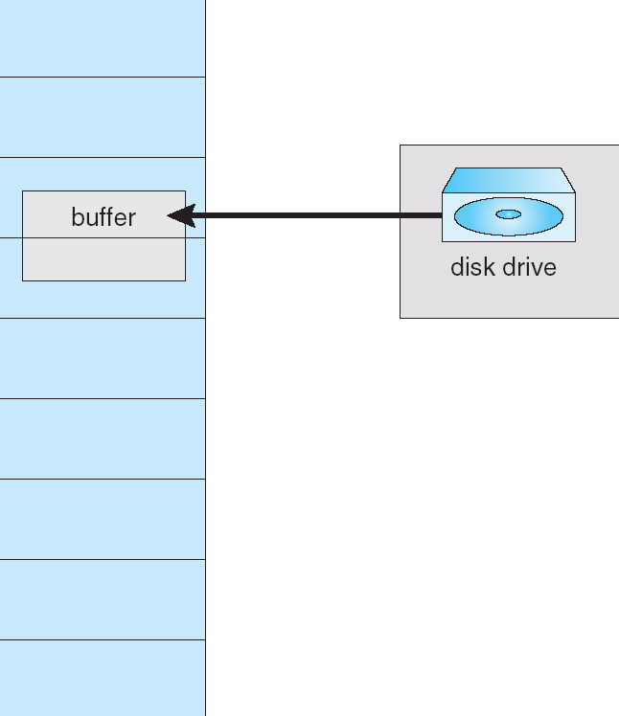
Reason Why Frames Used For I/O Must Be In Memory

Slide 57
Operating System Examples
Windows XP
Solaris

Slide 58
Windows XP
Uses demand paging with clustering. Clustering brings in pages surrounding the faulting page.
Processes are assigned working set minimum and working set maximum
Working set minimum is the minimum number of pages the process is guaranteed to have in memory
A process may be assigned as many pages up to its working set maximum
When the amount of free memory in the system falls below a threshold, automatic working set trimming is performed to restore the amount of free memory
Working set trimming removes pages from processes that have pages in excess of their working set minimum

Slide 59
Solaris
Maintains a list of free pages to assign faulting processes
Lotsfree – threshold parameter (amount of free memory) to begin paging
Desfree – threshold parameter to increasing paging
Minfree – threshold parameter to being swapping
Paging is performed by pageout process
Pageout scans pages using modified clock algorithm
Scanrate is the rate at which pages are scanned. This ranges from slowscan to fastscan
Pageout is called more frequently depending upon the amount of free memory available

Slide 60
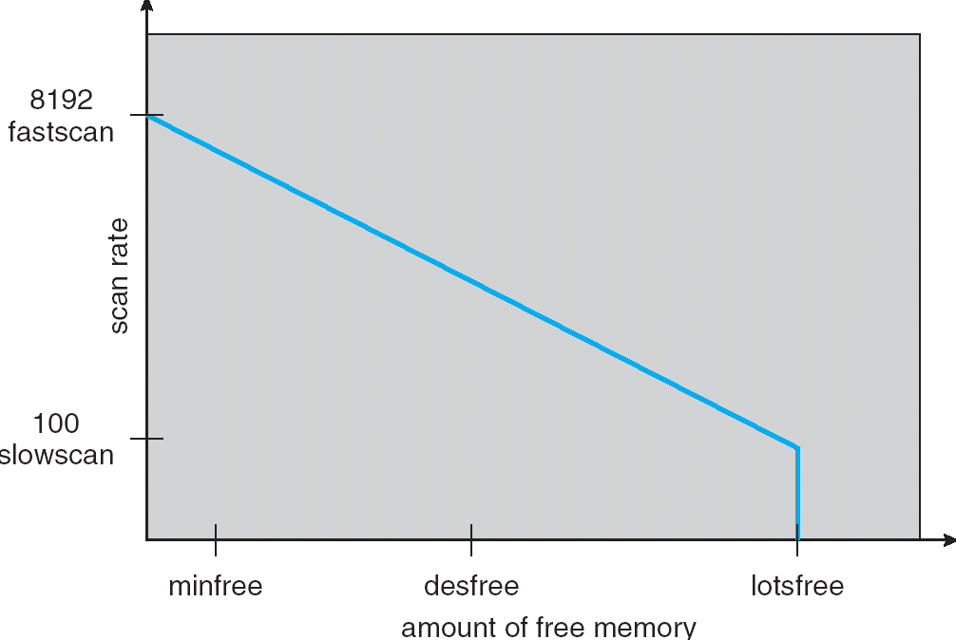
Solaris 2 Page Scanner

Slide 61
End of Chapter 9

